Slide 1


Slide 2

Announcements
Food choices for the Christmas Dinner are due, cut off is the end of the session so do it from your phones now if you haven’t
STEM Day on Saturday

Slide 3
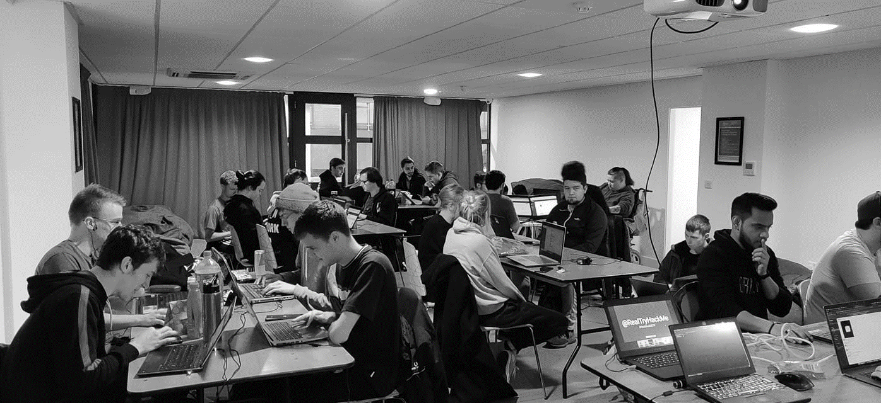


/dmuhackers
@dmuhackers
Steganography with a hint of Forensics

Slide 4


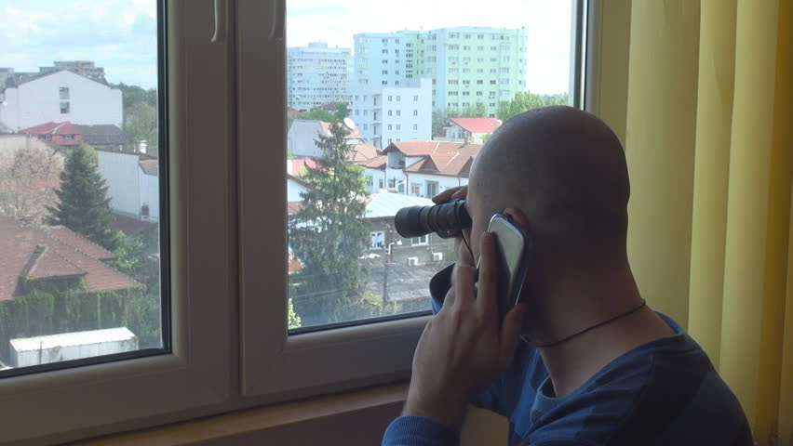
Disclaimer
Don’t be a creep

Slide 5

Overview
What is Steg?
Basics
JPEG
PNG
Tools
Non image steg
Forensics 101
Pub

Slide 6
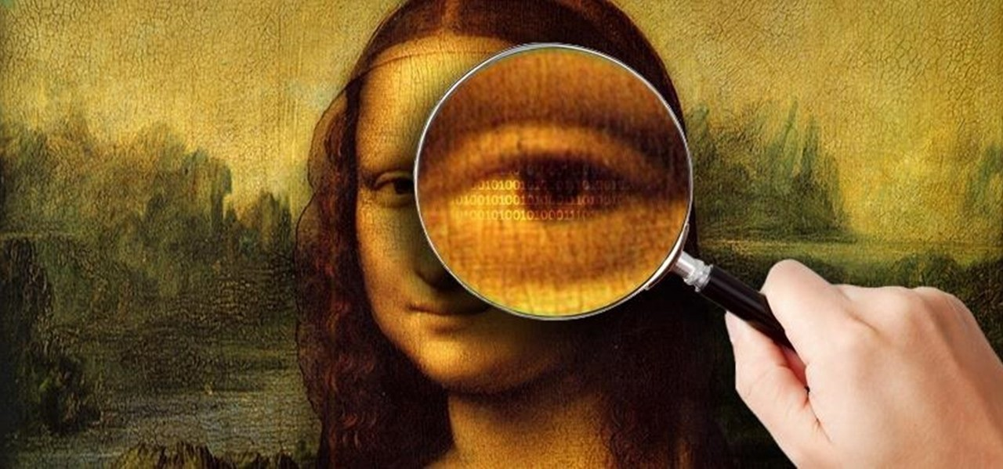
What is Steganography?
Steg is the act of hiding or concealing data within something that is readily available.
Cyber equivalent of invisible ink
Comes up in manyyyyyyy CTFs

Slide 7

The basics
File command – question everything
Strings
Grep
Text editor
Hex editor
Autopsy

Slide 8
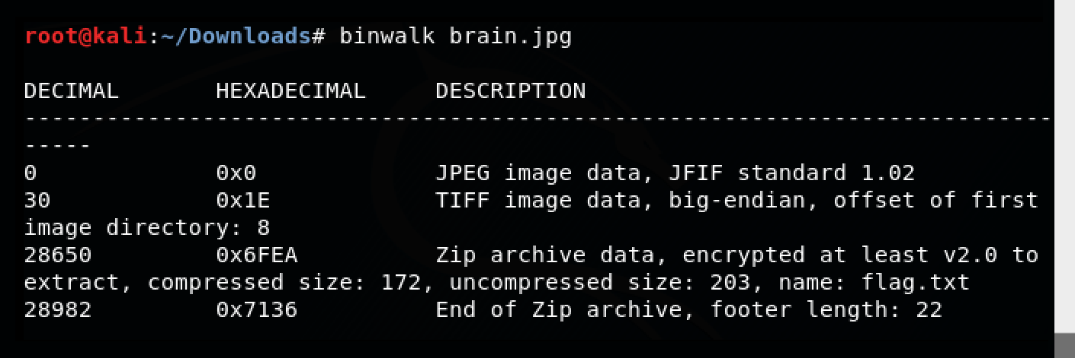
What to do if you get an image?
Most common form of Steganography is using regular images and the flag will be hidden somewhere inside
EXIF Data - https://exifdata.com/ // exiftool
Binwalk

Slide 9
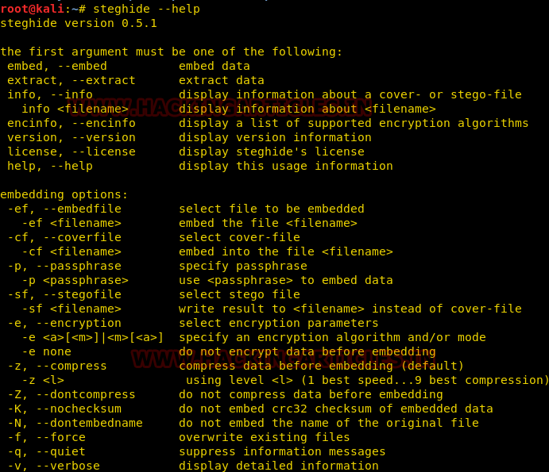


JPEGS - Steghide
-Create challenges
-Reverse the process
-Password protected ☹
-bruteforce?

Slide 10
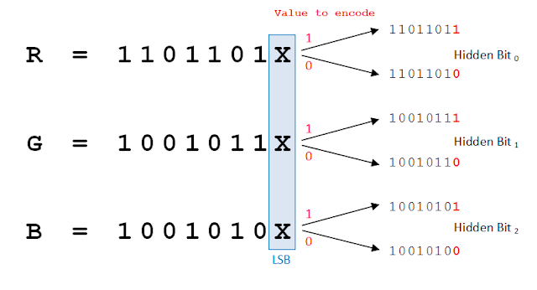
PNGs - zSteg
zSteg covers PNGs and you can use it to extract all the hidden data
Supports extraction of data hidden with the least significant bit and most significant bit method

Slide 11
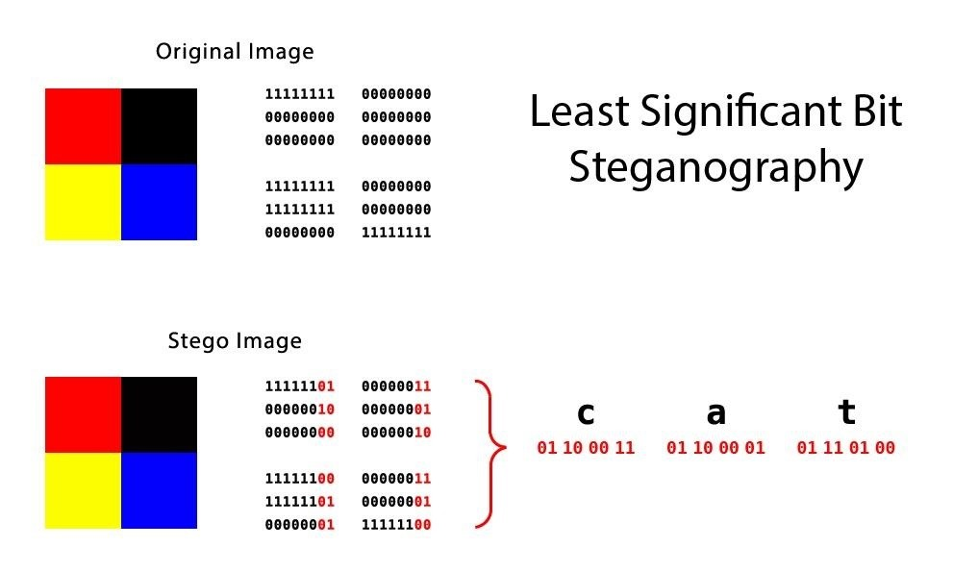
PNGs - zSteg

Slide 12

stegoVeritas
Installing
sudo apt-get install python3-pip
pip3 install stegoveritas
stegoveritas_install_deps
Used to automate the process and can be used on most filetypes, can be used to solve steghide issues

Slide 13
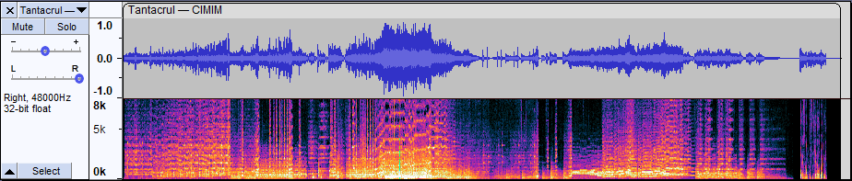
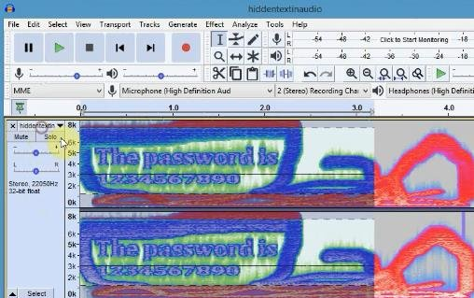
Just images?
AUDIO!
Sonic Visualiser // Audacity
Spectograms
Boundaries
Morse code

Slide 14
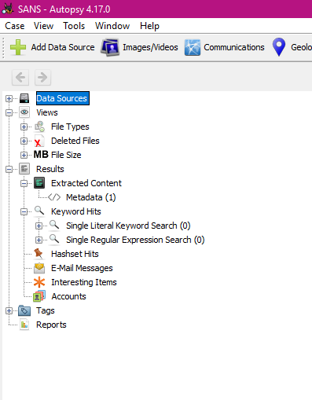

Other Forensics
Not all forensics will be an image file and turn into steganography, forensics is its own category of challenges
PCAP
Machine image
USB
Docker
Literally anything else
(more detailed talk next term)

Slide 15
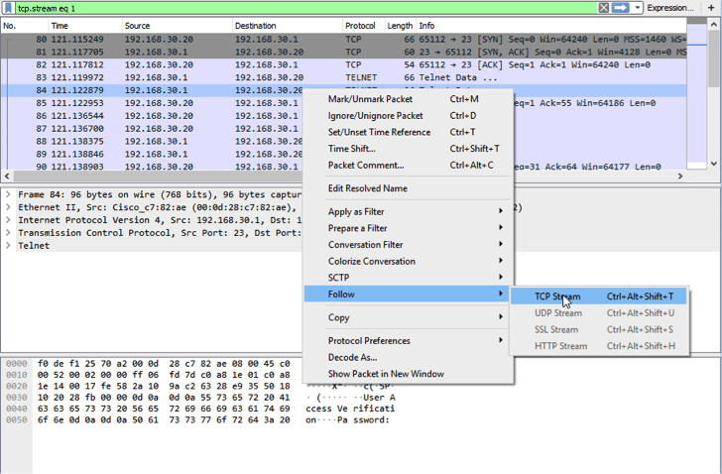
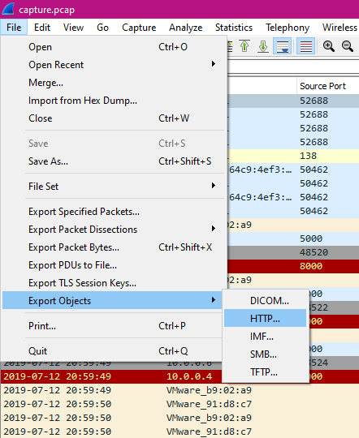
PCAP Analysis
Ranges in difficulty, you’re looking at a capture of network traffic

Slide 16
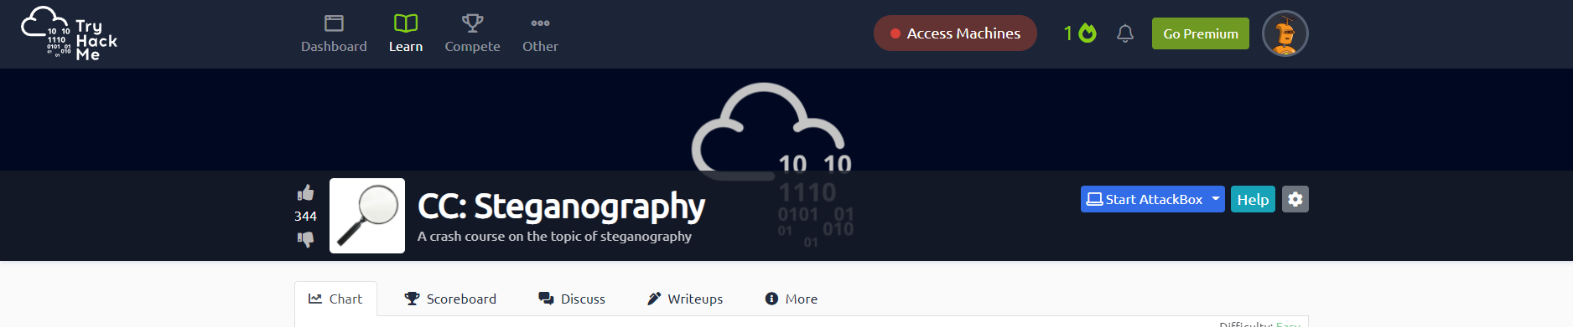
Questions?
@Bitsyi__

